Slide 1
Module 3: From Continental to World Power
Talk | Title | Time Period | Date of Talk
16 | Competing destinies | 1848-1854 | March 4th
17 | The Union falls apart | 1854-1861 | March 18th
18 | Civil War | 1861-1865 | Wednesday April 3rd
19 | Reconstruction & the New South | 1863-1900 | April 15th
20 | Conquest of the West | 1865-1890 | April 29th
18 | Civil War (Repeated) | 1861-1865 | Wednesday May 8th
21 | Triumph of capital | 1865-1900 | May 20th
22 | A world power emerges | 1890-1904 | June 3rd

Slide 2
American History
1
Talk 20: Conquest of the West (1860-1900)

Slide 3
Overview
The West 1860
West during the Civil War 1861-1865
Indian Wars 1860-1890
Wild West 1869-1880’s
End of the Frontier 1880-1890

Slide 4
The West 1860

Slide 5
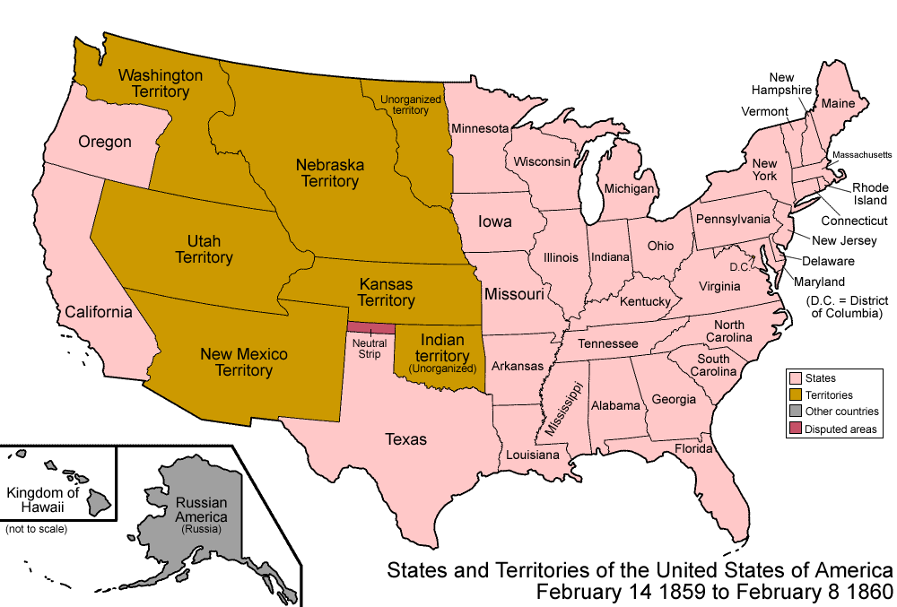
The West 1860

Slide 6
The “West 1860 …Less than 1 million people, no city> 100,000
Kansas Territory[12] | 107,206
New Mexico | 93,514
Utah Territory | 40,273
Colorado Territory | 34,277
Nebraska Territory | 28,841
Washington Territory | 11,594
Nevada Territory | 6,848
Dakota Territory | 4,837
California | 379,994
Oregon | 52,465
The "West" | 759,849
Major cities
San Francisco (California) | 56,802
Sacramento (California) | 13,785
Salt Lake city (Utah) | 11,000
Los Angeles (California) | 5,000
2% of US population of 31 million
Native American population approximately
400,000 (from 5 million prior to 1600)
Plus 35 million buffalo

Slide 7
The “West 1900” …7 million people,
California | 1,485,053
Kansas | 1,470,495
Oklahoma | 790,391
Colorado | 539,700
Washington | 518,103
Oregon | 413,536
South Dakota | 401,570
North Dakota | 319,146
Montana | 243,329
New Mexico | 195,310
Idaho | 161,772
Arizona | 122,931
Wyoming | 92,531
Alaska | 63,592
Nevada | 42,335
 | 6,859,794
Major Cities
San Francisco (California | 343,000
Los Angeles (California) | 145,000
Portland (Oregon) | 90,000
Seattle (Washington) | 81,000
Oakland (California) | 65,000
Salt Lake City | 53,000
US population increased by 129% to 71million
Population of West increased by 800%
Native American population reduced to 300,000
Only 2,500 buffalo!

Slide 8
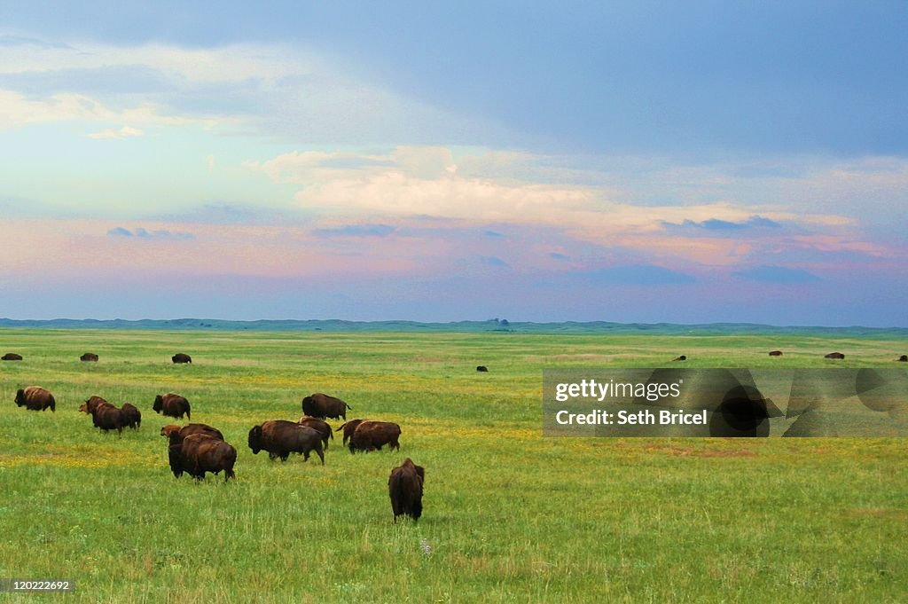
Nebraska territory….flat, millions of buffalo

Slide 9
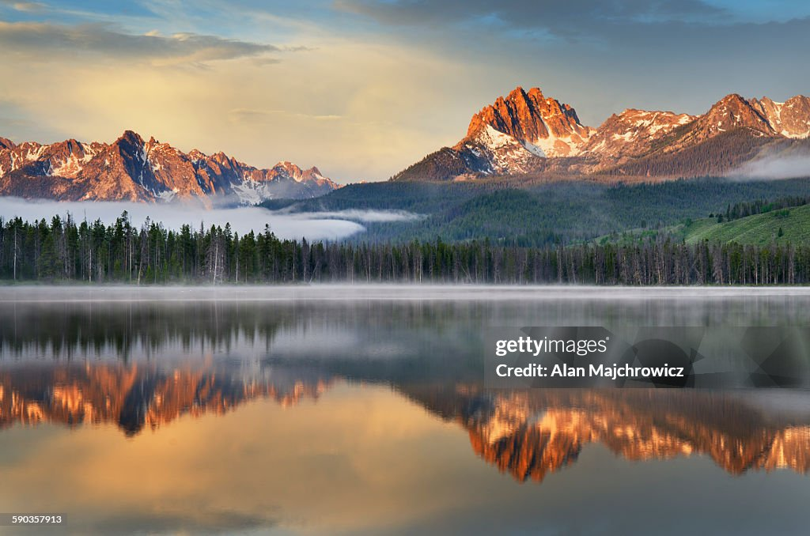
Idaho (Saw tooth mountains)

Slide 10
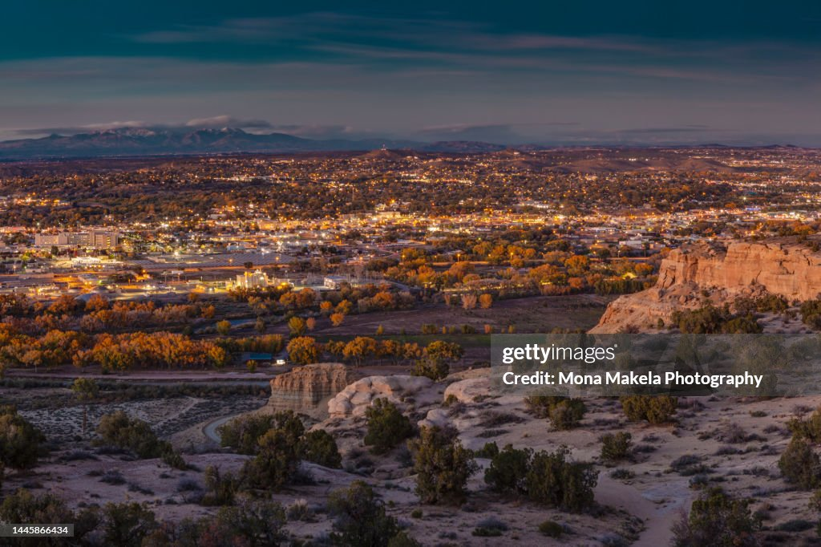
New Mexico

Slide 11
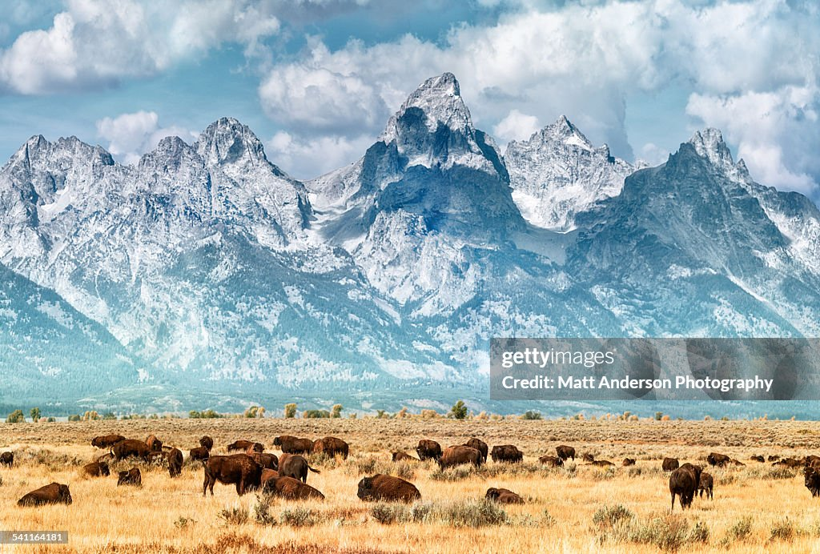
Wyoming

Slide 12
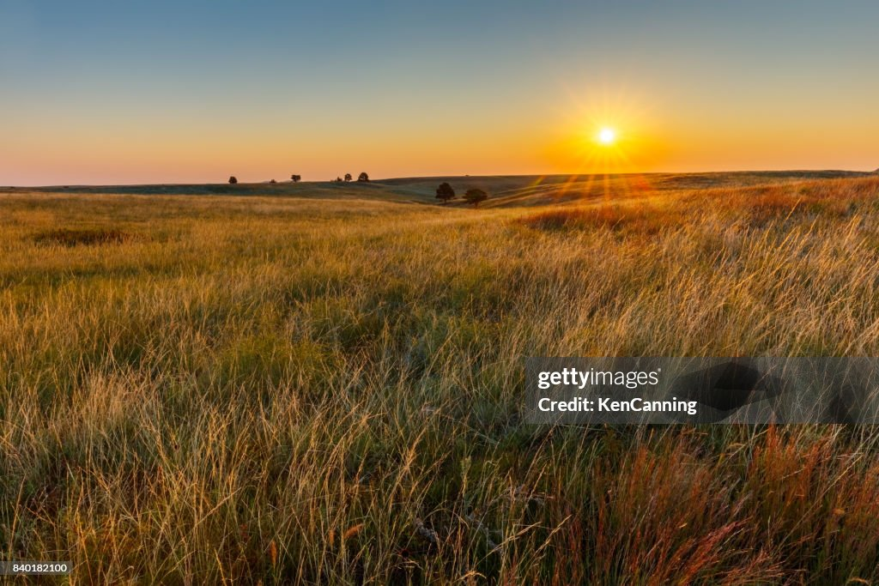
South Dakota

Slide 13
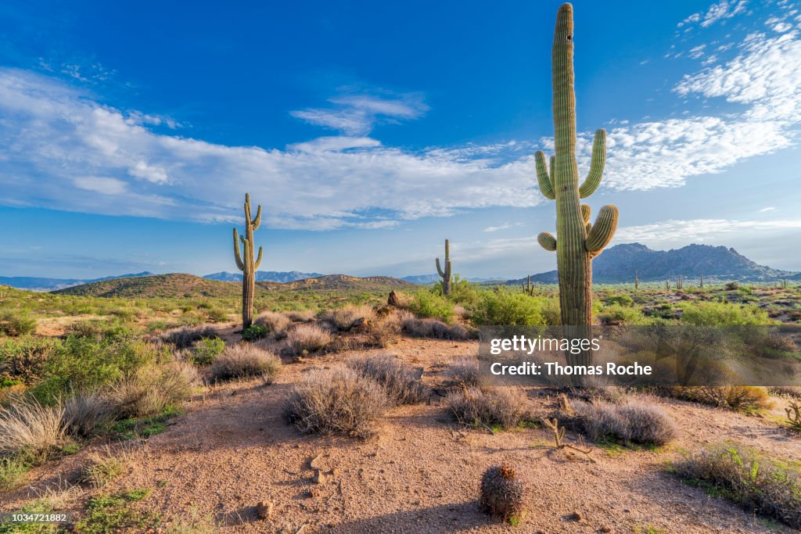
Arizona

Slide 14
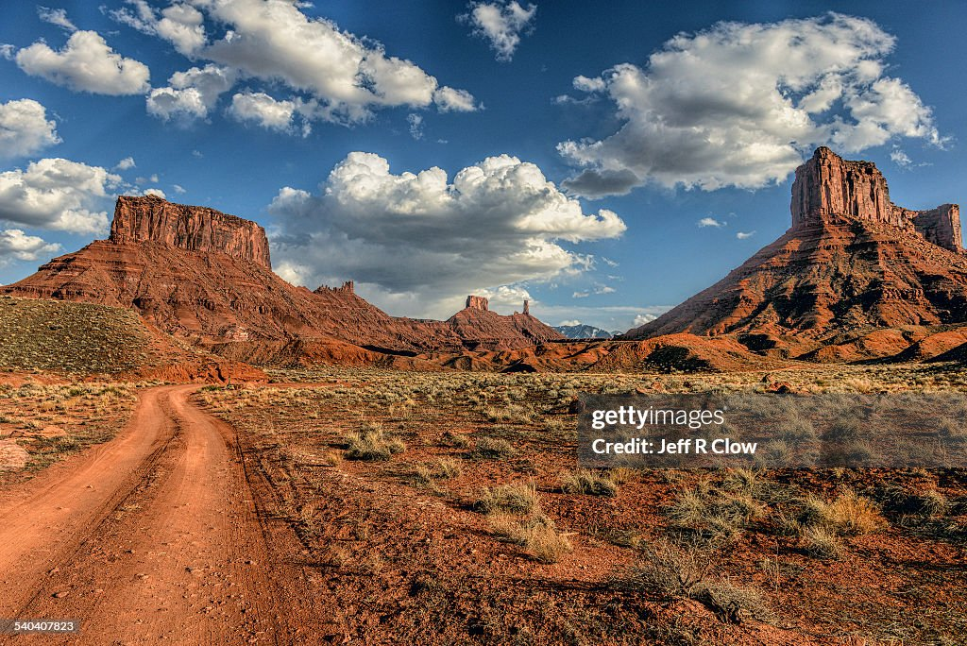
Utah

Slide 15
West during the Civil War

Slide 16
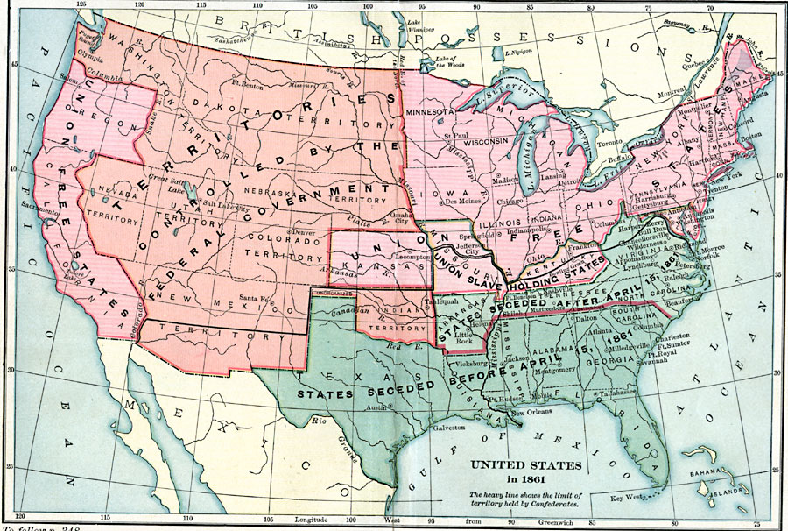
Civil War in the West
Southern invades
West…target ..support
“secession” of Arizona and attack California 1862
Competing slave
And free government
Missouri & Kansas
….battles…degenerates in
4 year guerrilla war
Indian Territory
…mostly neutral

Slide 17
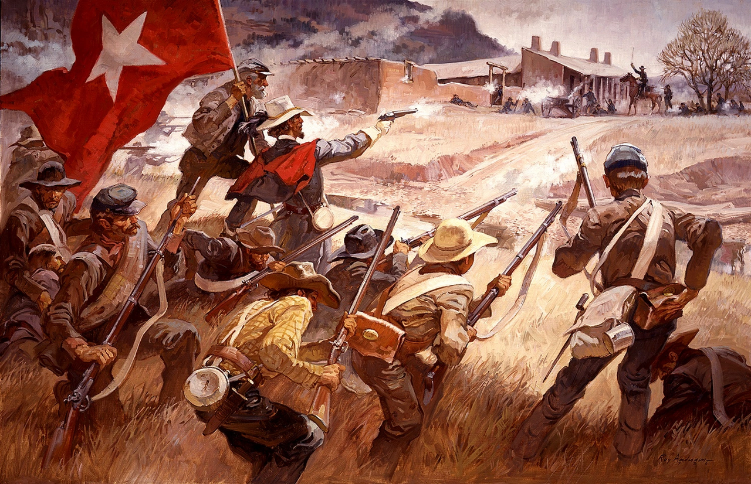
Southern “invasion” of New Mexico
Power vacuum as US army moves East
Settlers in Southern New Mexico create separate government/ North most Mexican…hate Texas and support North
South sends army of 5,000 to support rebels and attack California
Northern army arrives, South blocked at battle of “Glorietta Pass” 1862 and abandons plans
Threat to California and emerging plan to build Trans Continental Railway secured

Slide 18
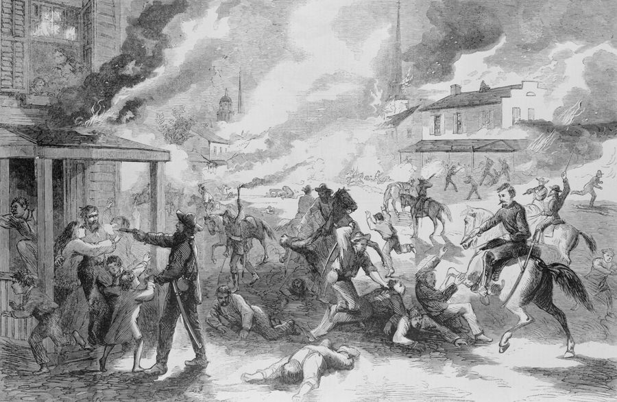
Guerrilla warfare Border states 1861-1965
Lawrence Kansas massacre 1862
Major battles 1861 -1862 , major armies
Move east….creating vacuum
Guerrilla war rages 4 years,
Pro slavery: “Bushwhackers” Free Soil
Individual And mass killings, murder of prisoners
Burning towns….men only…25,000 killed
In Missouri …female slaves raped
Lawrence Kansas 1863…200 civilian
Men killed….
Union army evicts “pro slavery”
Settlers…20,000 forced to walk to Texas
Fighting continues till end of war..
Most “bushwhackers” dead

Slide 19
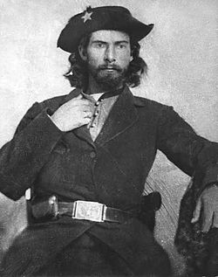
“Bloody Bill” Anderson (1840-1864)
Anderson 1864
Quiet reserved boy, respectable family …Father horse trader No slaves,,,steals horses for Southern army
Mother killed by lightning 1860 Father shot dead resisting Arrest for assisting horse stealer. Anderson kills father’s killer
Sisters captured by northern troops, one dies in (accidental) fire…Bill enraged….
Joins “Quantrill Raiders,
…….. Lawrence massacre
………holds up train, kills soldiers
…….. Murders union farmers, rapes
black maids
……collect scalps and decorates horse
Killed 1864, 54 scalps on saddle
Training ground for Jessie & Frank James and other future
outlaws…..legacy of violence and glamour

Slide 20
American Indians and Civil War
Indigenous people split into three factions
Neutral….majority of tribes consider this a….”White man’s problem”
Slave owning Cherokees, other tribes seek revenge and support South
Some Indians supported North…seeking future security
Multiple small scale skirmishes…everyone fighting everyone
Regular Army abandons West/ Settlements slow down
Last chance for Indians to unite…5 years respite
….. No Tecumseh
Civil War legislation shapes future of West ..and doom of the Indians
Homestead Act of 1862, Trans Continental Railway

Slide 21
Homestead Act 1862 : background
Jeffersonian ideal
America the Land of ‘yeoman farmers”
Manifest Destiny to exploit and make the West productive
Land Grants prior to Civil War
Donation Land Grant 1850…400 acres Oregon territory white and mixed race (white/Indian)
Republicans want West opened up to small farmers, not ‘plantation class’
Southern Democrats want land opened to “slave labour” and major land owners
The Result : Impasse
Southern Democrats leave Congress at start of Civil War
Transformational legislation meets no resistance

Slide 22
Largest transfer of property to private individuals in history
270 million acres of land opened for settlement
10% of United States land allocated to program
1.6 million settlement creates 1862-1934
Open to citizens and immigrants regardless of race or religion
Excludes “anyone taking arms vs United States….ex Southern
soldiers….former guerrillas
News broadcast across world
…..agents sent to Europe to encourage settlers
….on hold till war over…..a tidal wave building..

Slide 23
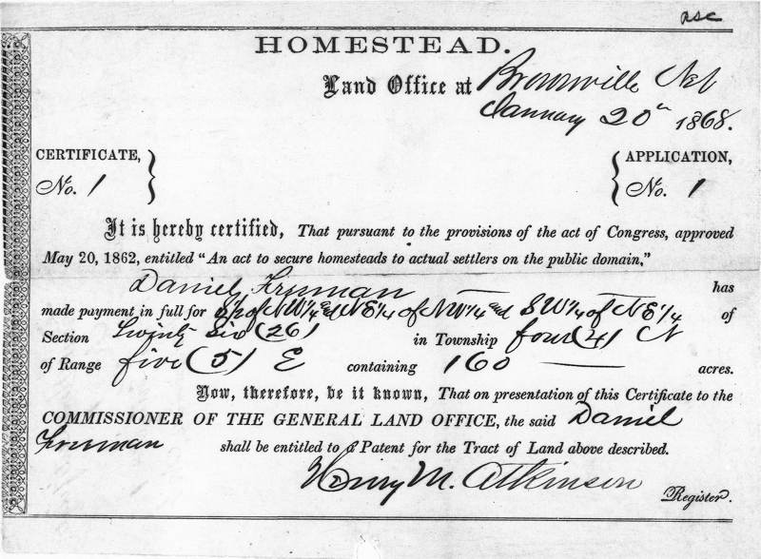
The Deal
Filing fee of $18
Individual/ family must pay
To get to land
Occupy and ‘improve’
Land over five years in
Exchange for full ownership
(Northern soldiers deduct years
Of service)
Owner must build 12 X 14
Dwelling..…did not specify
measurement
…some ‘houses’ built in inches
…many abuses
…speculators & fraudsters,

Slide 24
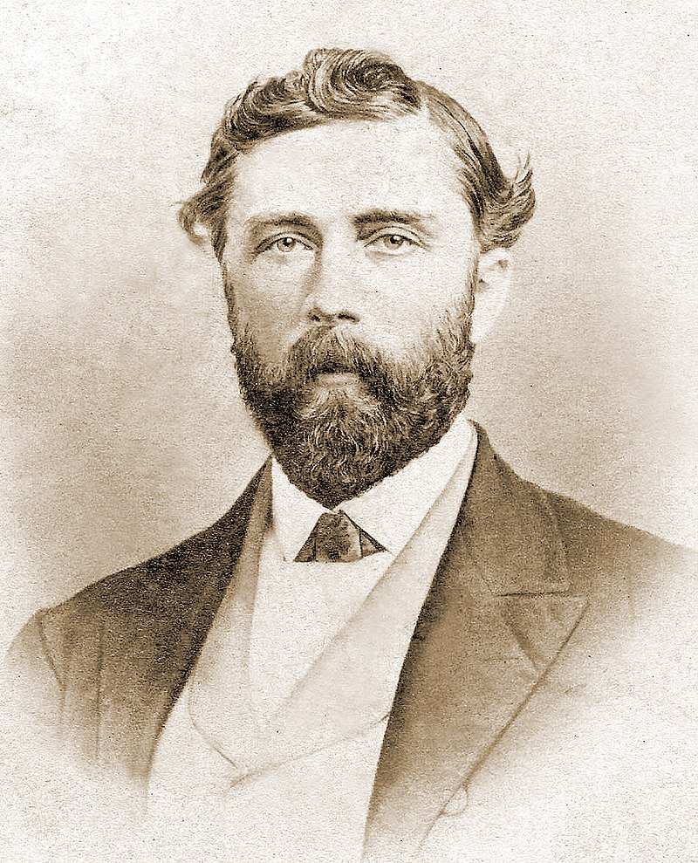
Transcontinental Railroad: The Visionary
The idea: Northwest Passage to Asia to beat Europeans,
…..debated since 1807
Theodore Judah 1826-1863
Impasse on route
….South vs North
…Civil war ends debate : Northern wins
Theodore…Civil Engineer
railroad obsessed…surveys area
Writes proposal
Gets attention from “Big Four”
Lobbies congress , business
Gets proposal approved
…dies of yellow fever returning from
California to New York

Slide 25
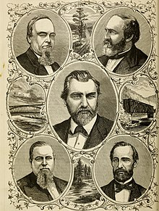
The “The Big Four
Crocker
Huntington
Stanford
Hopkins
…”The Associates”
Heroic entrepreneurs
Or “greatest swindlers
Of the century”
..future leaders of
California politics
& business

Slide 26
Pacific Railroad Act 1862
6 % Bonds to be raised as each mile of track complete
$16,000 ($500,000) per mile flat,
$32,000 ($1,100,000) ‘foothills”
$48,999 ($1,500,000) mountains
Railroad granted land 10 miles each side of track each of land either side of track (equal to Homestead Act) plus additional grants from states….total 180 million acres (more land than state of Texas)
Two companies given monopoly
Union Pacific …Big Four
Northern Pacific….Banks and individual investors each limited to 10% (Mormons)
1,700 miles of track, $50 million bonds $1.2B 2024

Slide 27
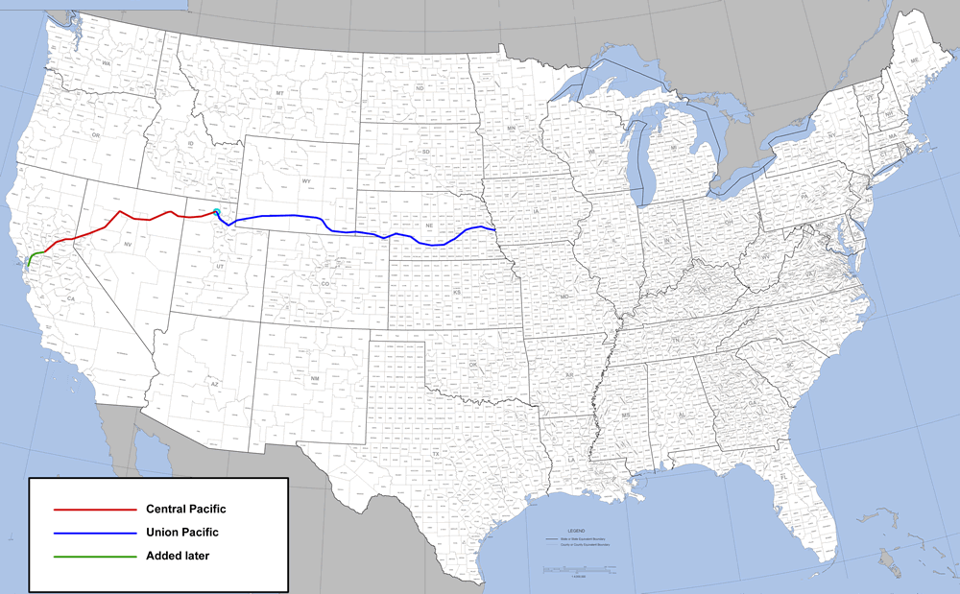
The railway: meeting point dependent on progress
Union Pacific
Northern Pacific

Slide 28
Building the Railroad
Northern Pacific East to West
5,000 Irish labourers, mostly ex soldiers paid up to$50 month and supplied food…frequent strikes, discrimination
Flat, slow rising land.. 4 tunnels
Sporadic Indian attacks and killings/ US army accompany
Union Pacific West to East
Unable to source local white labour
15,000 Chinese (many ex gold miners) , 1,000+deaths
Mountains/ 15 tunnels 500 bags of black powder explosives per day
Paid $26 dollars pay a month, work 6 days a week, bring own food
Strike in 1867……pay increased to $30 month/ no free food

Slide 29
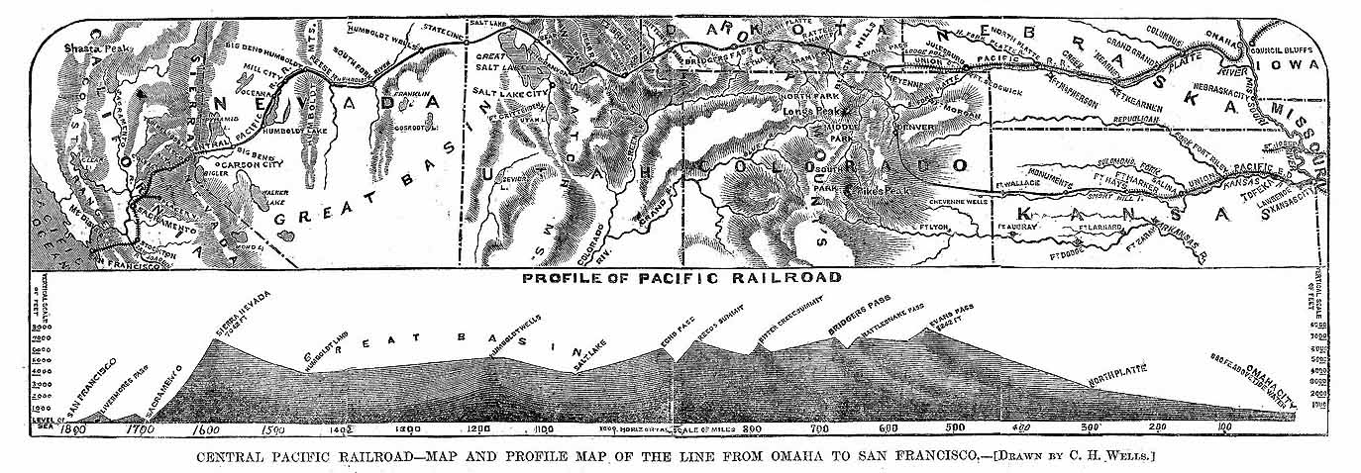
The challenge
Union Pacific
Northern Pacific

Slide 30
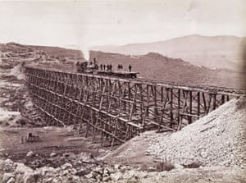
Wooden bridges Northern Pacific

Slide 31
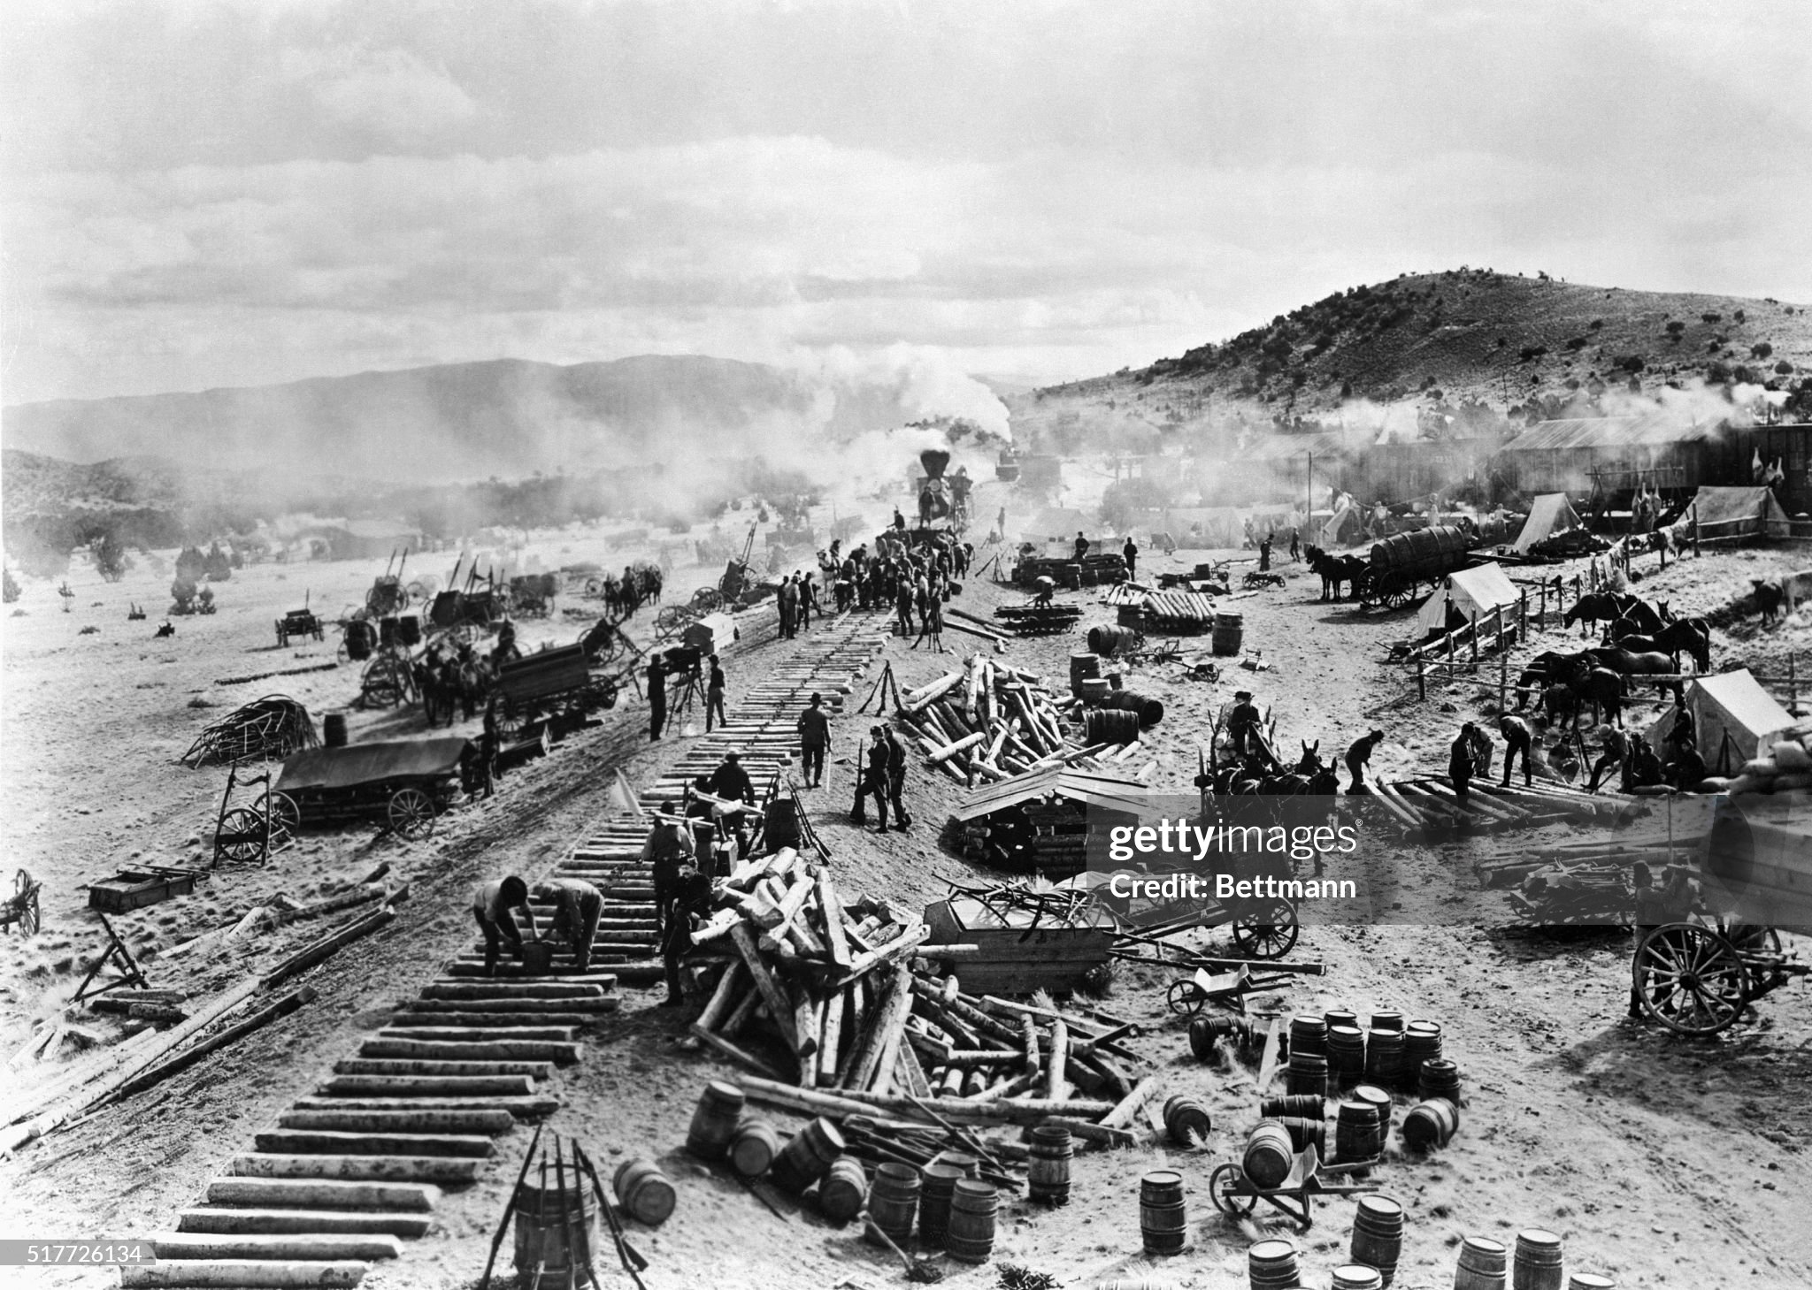
Northern Pacific….working westward

Slide 32
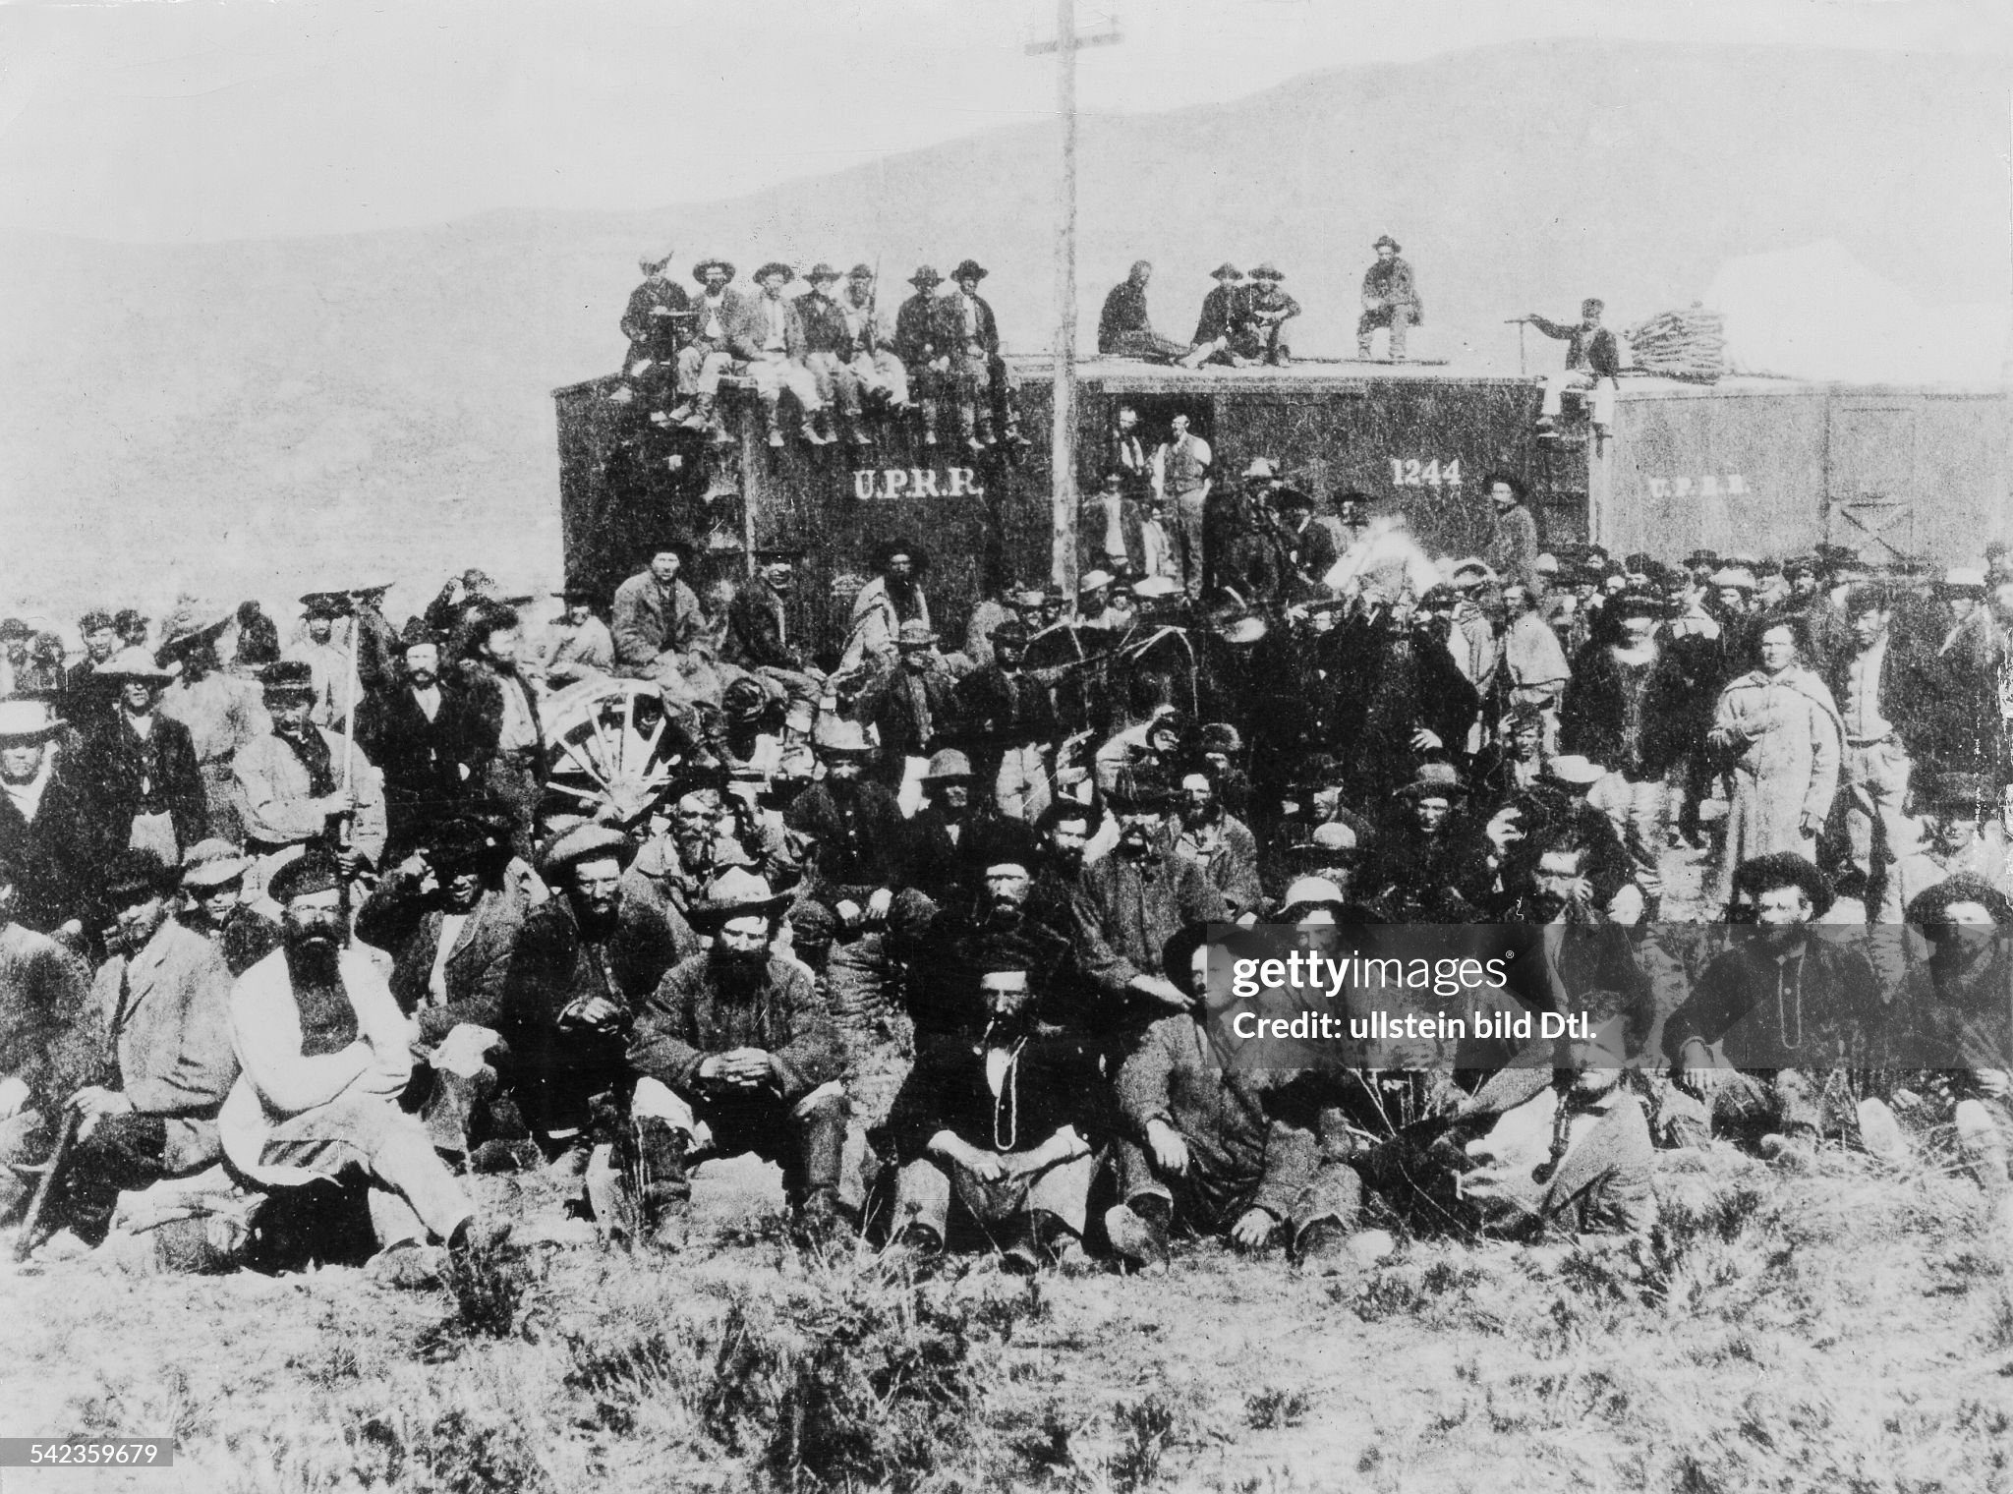
Union Pacific….heading east,

Slide 33
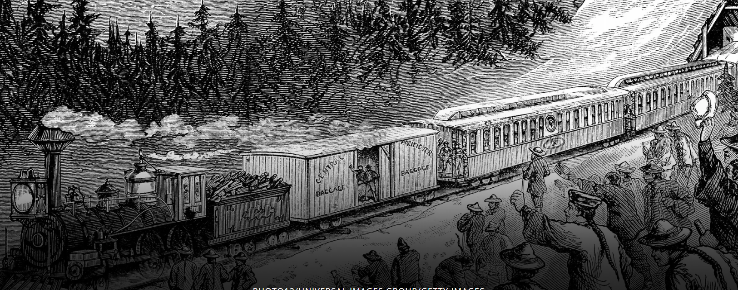
Union Pacific: Chinese labourers thru Sierra Nevada mountains

Slide 34
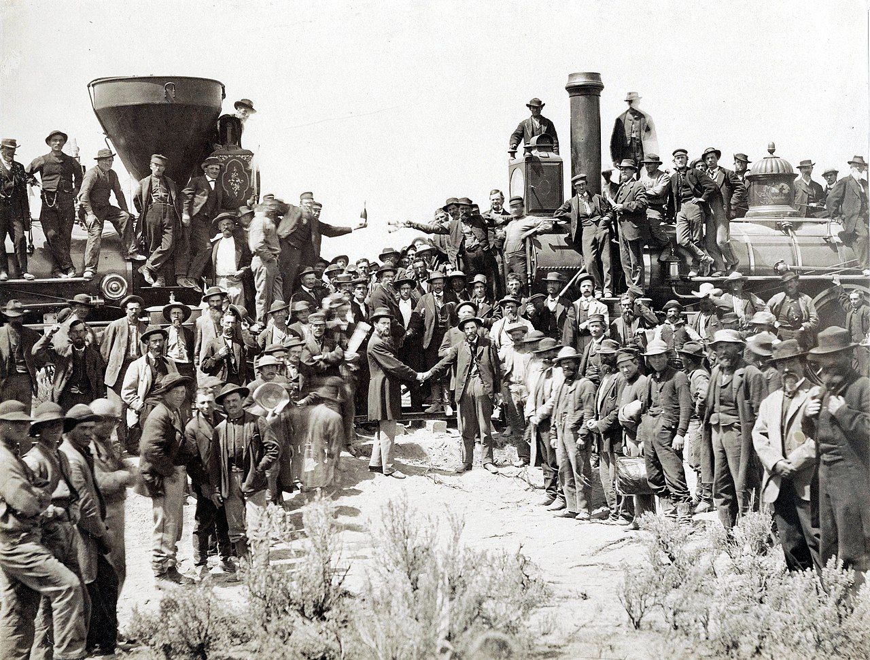
Two Lines meet at Promontory Point July 9 1868

Slide 35
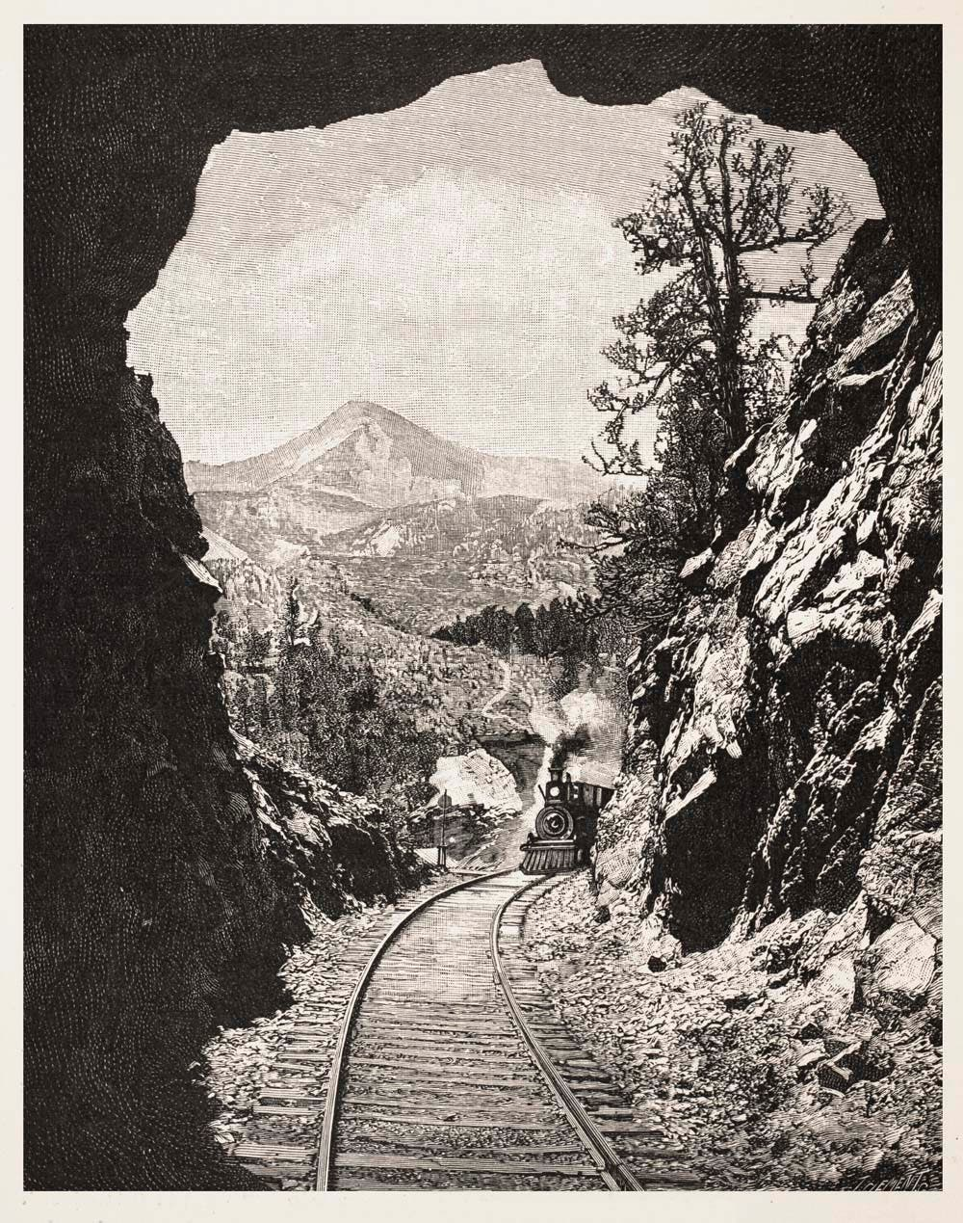
Union Pacific: Summit Pass 7,000 ft., 500 metres long

Slide 36
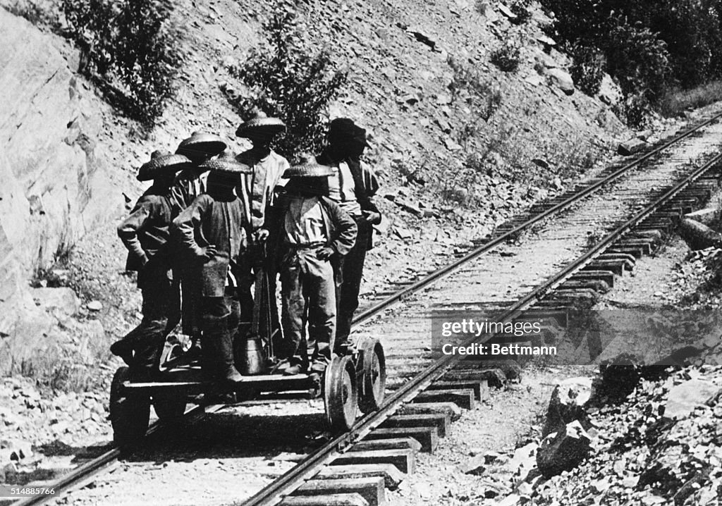
Chinese workers Union Pacific

Slide 37
Impact Transcontinental Railroads
Journey time from East to West Coast reduced 3-4 months – 1 week
Price drops $1,100 to $150
Integrates east and west coast markets: minerals, food stocks
Settlements expand…safe, fast, cheap
Indian lands vulnerable everywhere and ready to be taken

Slide 38
Indian wars 1860-1890

Slide 39
Plains Indians
Multiple “nations” subdivided into “tribes” and bands
Sioux “Nation”: subdivided into tribes and bands Dakota, Lakota, Olaga and more
Nomadic settlements: bands of 3,000, 5,000 ….total population 200,000 by 1860,
No common language, informal shifting governance
Culture of warfare
constantly at war with each other, informal chief democratic
Males/ hunt ….women cook, look after children
Ritual use of torture on male victims, absorbing females and children into tribe
Sustained by 70 million buffalo
Horse culture enabled expansion since mid 1700’s
Many tribes recent settlers, forced from Mid West by white settlers

Slide 40
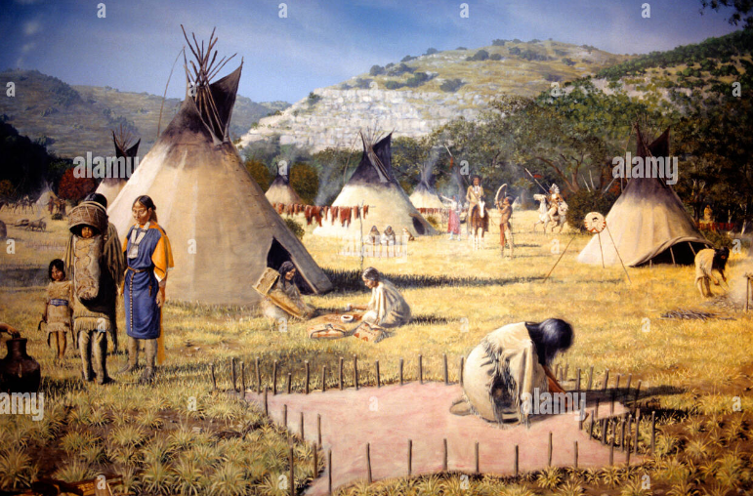
Plains Indian camp

Slide 41
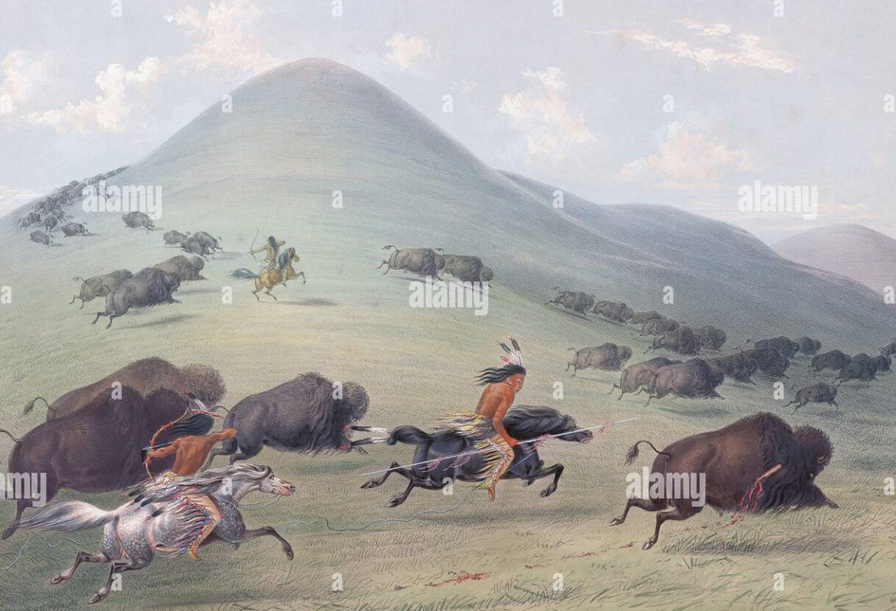
Buffalo hunting….central to existence for food, clothing, shelter

Slide 42
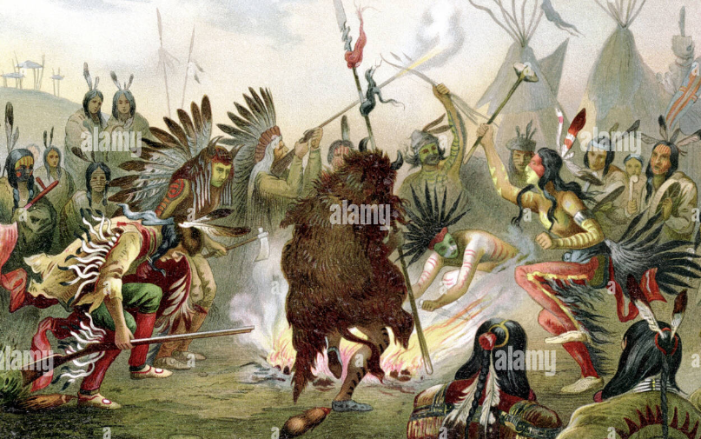
Sioux War Dance

Slide 43
Plains Indians Religion
Black Elk 1860’s
"We should understand well that all things are the works of the Great Spirit. We should know that He is within all things: the trees, the grasses, the rivers, the mountains, and all the four-legged animals, and the winged peoples; and even more important, we should understand that He is also above all these things and peoples. When we do understand all this deeply in our hearts, then we will fear, and love, and know the Great Spirit, and then we will be and act and live as He intends".^{[2}
Ancestor worshipped and present among the living
Land as “usufruct”…land granted to all by “Great Spirit” to be left as received.

Slide 44
Indian Wars
Multiple disconnected mini wars 1860-1890
15,000 Indians, 7,000 soldiers settlers killed
50% Indian population die from disease and starvation
Indians outnumbered 2 vs 1 1860, 40 to 1 by 1890
Similar pattern
Initial hostilities, killings as settlers move in and kill wildlife
Treaty signed with “chiefs” by US military
Indians give up land and move to reservations in exchange for grants & food
More settlers arrive, gold, silver discovered
New treaty signed with alternate “chiefs”, land reduced,
Food not distributed, Indians starve
Young revolt….murder settlers,
Army returns …can’t find Indians, attack camps, Indians surrender, lose land, reservations
Fighting merciless, indiscriminate (Indians usually spare women and children)

Slide 45
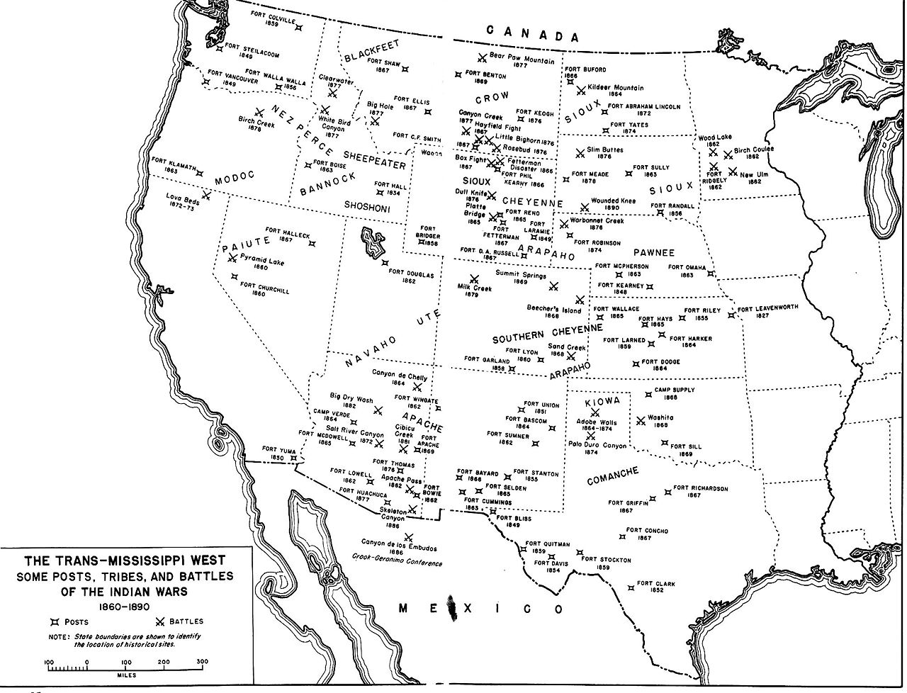
Indian Wars 1860-1890

Slide 46
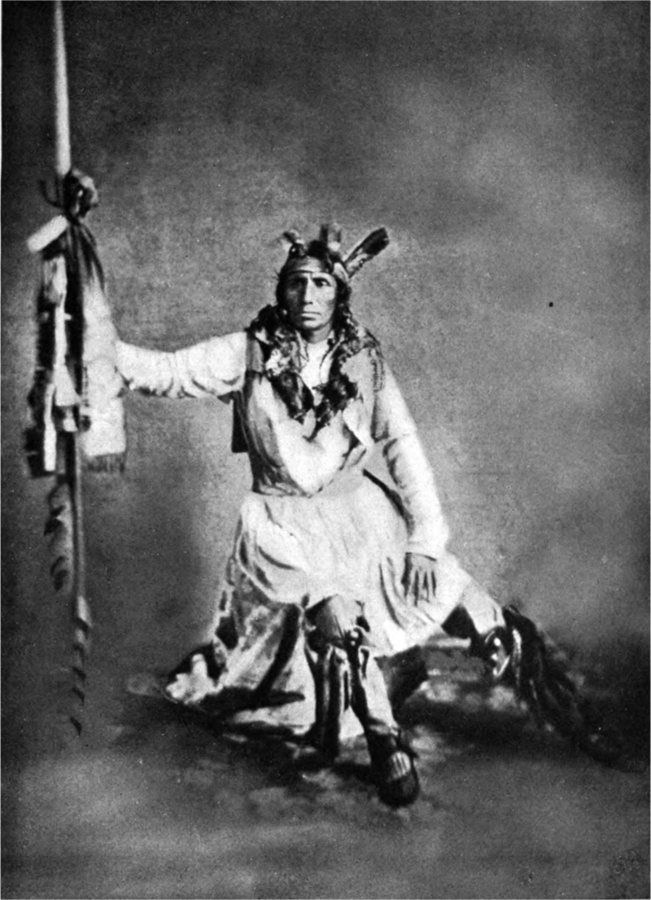
Sioux Rising 1862
Little Crow
Sioux moved to reservations prior to civil war…conflict other tribes, settlers move in
Army leaves, food distribution breaks down .corruption & disruption …starvation…army moves east
Reservation manager tells Indians to “eat grass”
Little Crow leads break away band attack
…decapitate manager, Insert grass in head
…500 settlers slaughtered
…1000’s settlers refugees
Lincoln orders army to return
Army of 1,700 defeat 500 Indians
Indians surrender

Slide 47
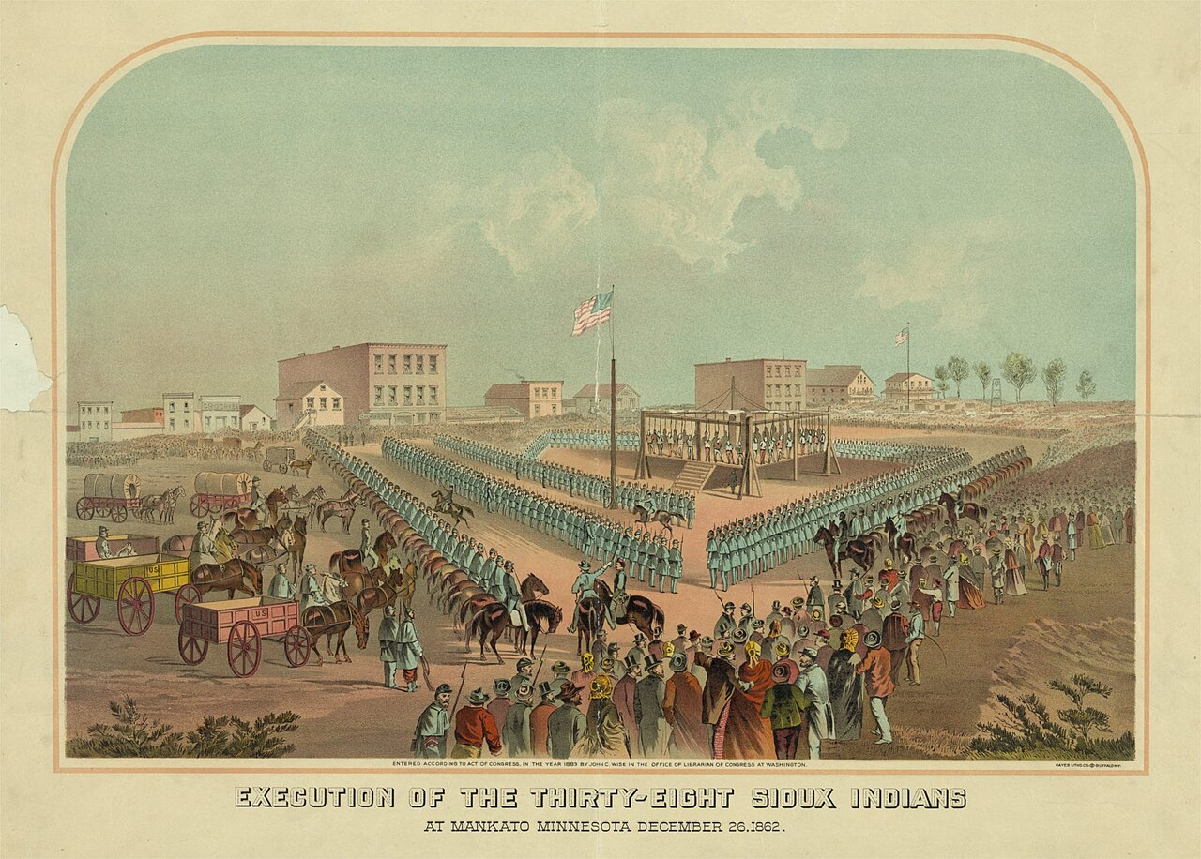
Mass execution Sioux rising 1862
Army puts Indians
On trial, sentences
350 to death
Lincoln commutes 320
…including Little Crow
38 hanged at largest mass
Hanging in US history
….arbitrary definition of
”combatants”
….Little Crow spared
… murdered by settler 1 year
later

Slide 48
Colorado “War” of 1864
Fort Laramie Treaty 1859..Cheyenne chief Little Kettle secures adequate land
Gold discovered Colorado 1859, miner pour into territory
Settlers/ miners murdered….army responds, New Treaty…Indians lose 90% of land
Elders accommodate, alternate extermination young revolt, murder settlers
Army sent to impose order...all Indians alike
“Black Kettle” Chief agrees with treaty, flies US flag outside camp, most men absent hunting
600 Cavalrymen led by Colonel Chivington attacks camp with remit to “eliminate” Indians

Slide 49
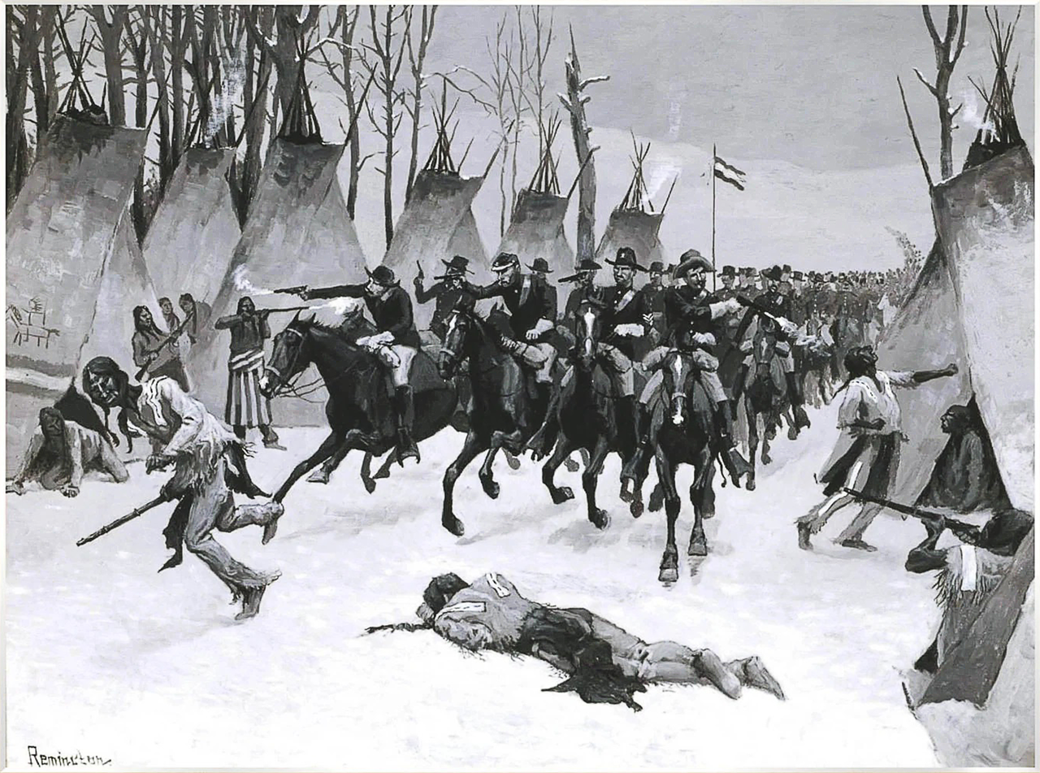
The “battle” of Sand Creek 1864
1900 painting…army attacking camp
The reality:
“I saw the bodies of those lying there
cut all to pieces, worse mutilated than any
I ever saw before; the women cut all to
pieces ... With knives; scalped; their brains
knocked out; children two or three months
old; all ages lying there, from sucking
infants up to warriors ... By whom were
they mutilated? By the United States troops ...
— John S. Smith, Congressional Testimony 1865
500 Indians killed, all but 50 women and
Children. 25 soldiers killed
……US Commander “hero”in press
Grant considers Chivington a disgrace
…..court martialled but acquitted

Slide 50
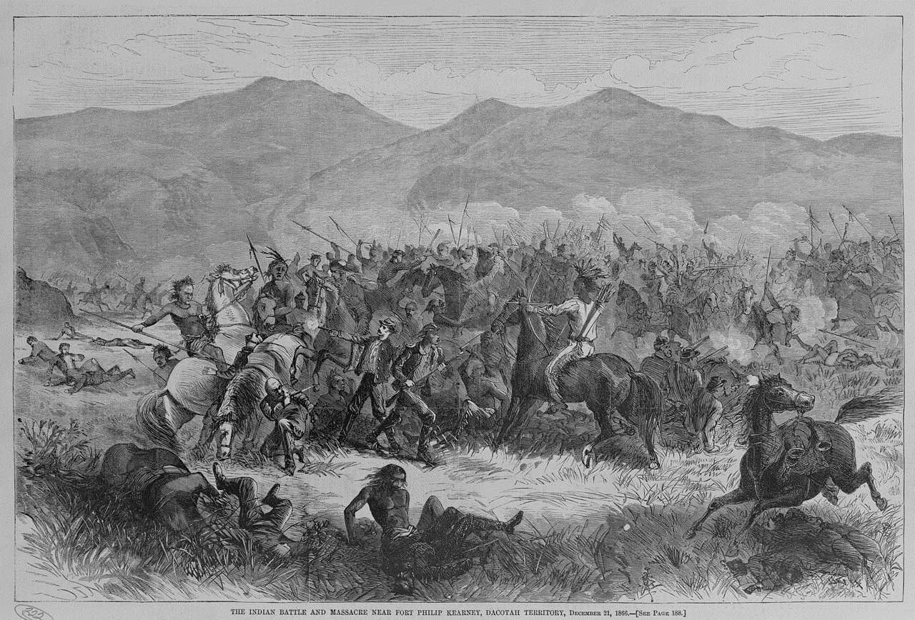
“Red Cloud’s War” 1866
“Fetterman Massacre”
Sioux expand South, defeat
Cheyenne. aggressive
Trails developed through
Indian Lands….”Red Cloud”
Protests….ignored
Army of 1,000 sent…under
Funded…using muzzle loading
Guns.. Indian force of 2,000
Surround fort…skirmishes
Indians…90% bow & arrows
Company decides to attack
..no reconnaissance.. 80 killed
Further fights. US decide to
Accept Red Cloud terms
Fort Laramie..Sioux dominate
Area 8 years…till gold

Slide 51
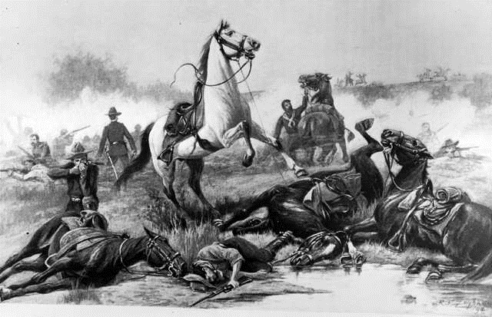
Battle of Beechers Island 1868…new technology
Indian raiding parties: revenge
Vs Sand Creek. Settler encroachments
Army patrol of 50, all with repeating
Rifles attacked by 900 Cheyenne led by “Roman Nose”
Soldier led by Captain Beecher
Dismount, hold position….repel attacks
Roman Nose…goaded into attack
…killed . Indians retreat
…relief column appears
…Cheyenne give up…75 dead vs
6 cavalryman…..tactics forgotten

Slide 52
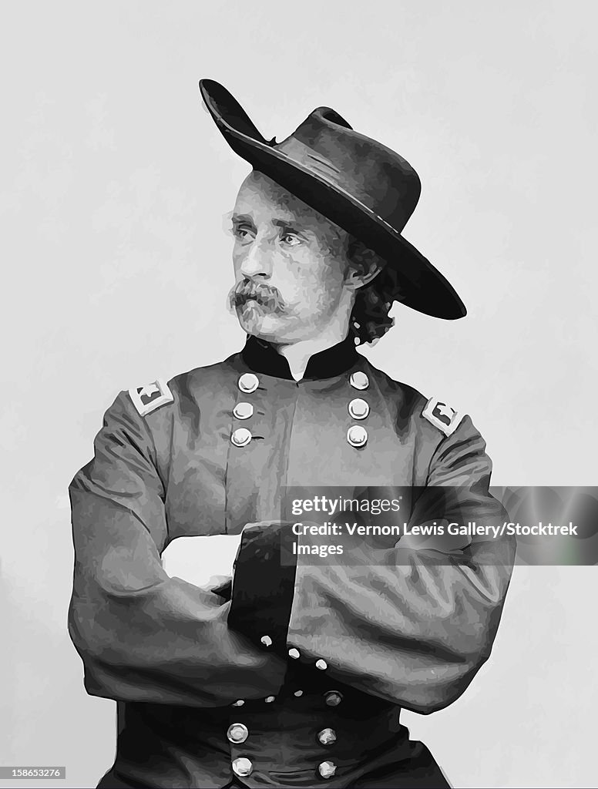
George Armstrong Custer (1839-1876)
Born Ohio, English &
German immigrants, father
blacksmith
Last in class at West Point
Brave reckless in Civil War
Rises up ranks, awards for bravery
Lieutenant Colonel of cavalry
At age 25
Leads 7th cavalry in Indian wars
Delivers “Sand Creek” style
Attack at “Battle” of Washita
…200 Indians killed 50 males, 150
Women and children
…sends 20 men ahead to scout
…all killed
…newspaper considered hero
..self publicises….along with wife

Slide 53
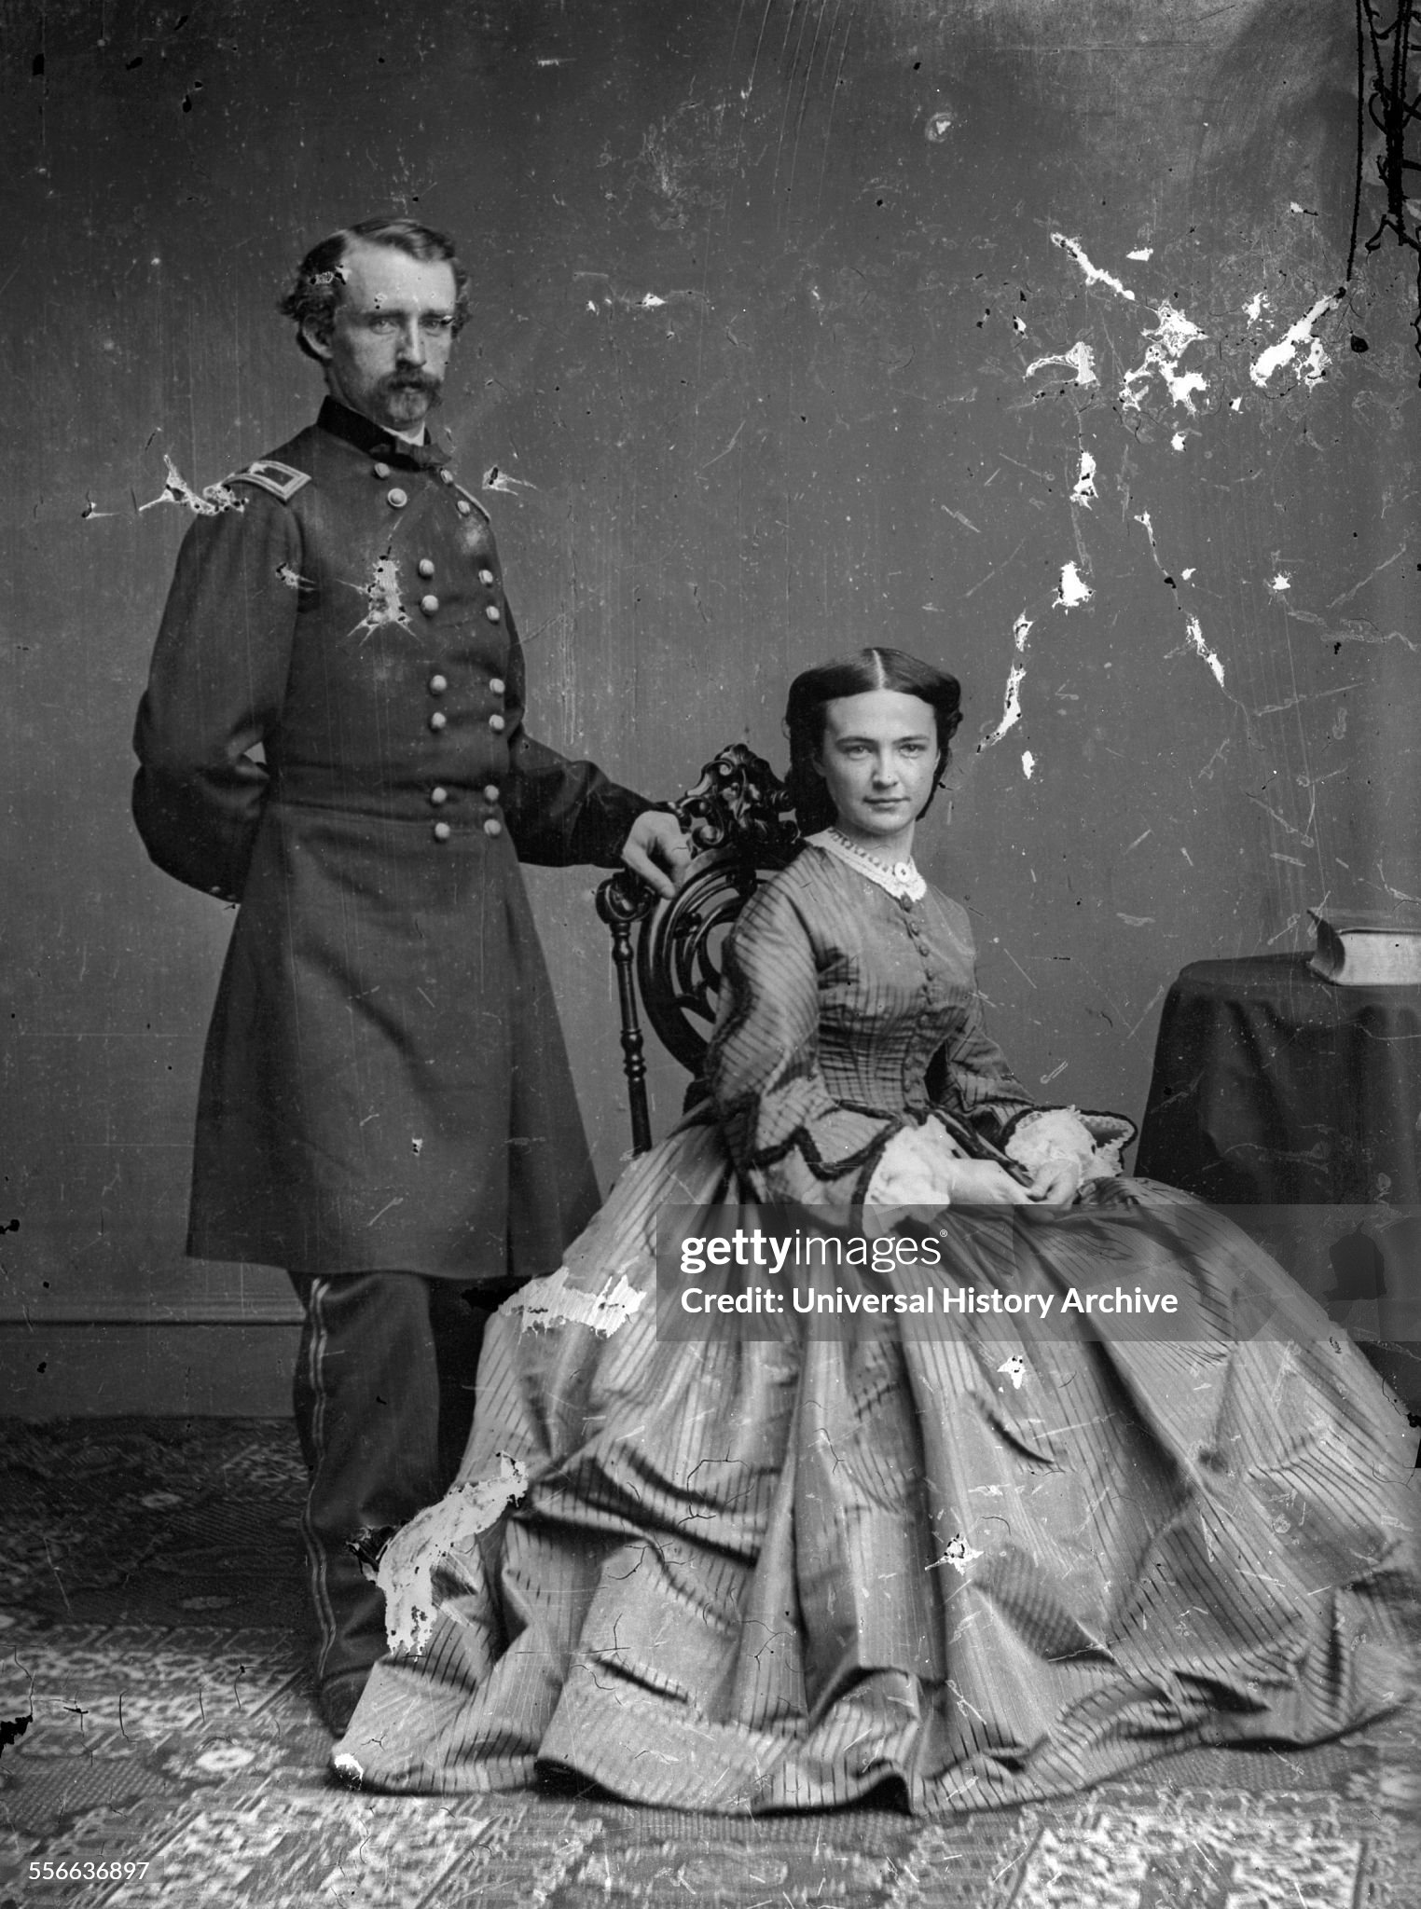
George Armstrong Custer and “Libbie”
Marries up to Elisabeth
Daughter of judge father
Objects but agrees when
Custer promoted to Colonel
Turbulent marriage
George…gambler,
Womaniser, preyed
on captive Indian women
Both court press….
Custer “hero of the west”
Accompanies husband on
Campaigns….”blogger”

Slide 54
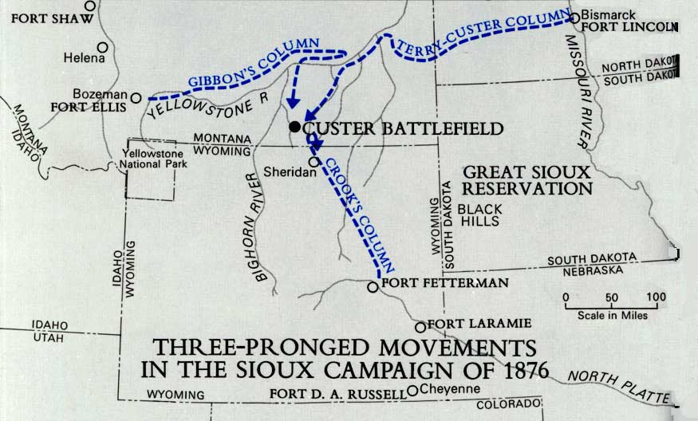
Big Horn Campaign
Sioux starving…leave
Reservation.. Dynamic
Spirit lead Sitting Bull unites
with neighbouring tribes
….makes up camp
….up to 3,000 warriors
…largest Plain Indian
Force ever assembled
“Custer quote “there
Are not enough Indians
In the world to defeat
The Seventh Cavalry”
Divides force of 600 into
Three columns
Decides to attack
Indian camp…without
reconnaissance

Slide 55
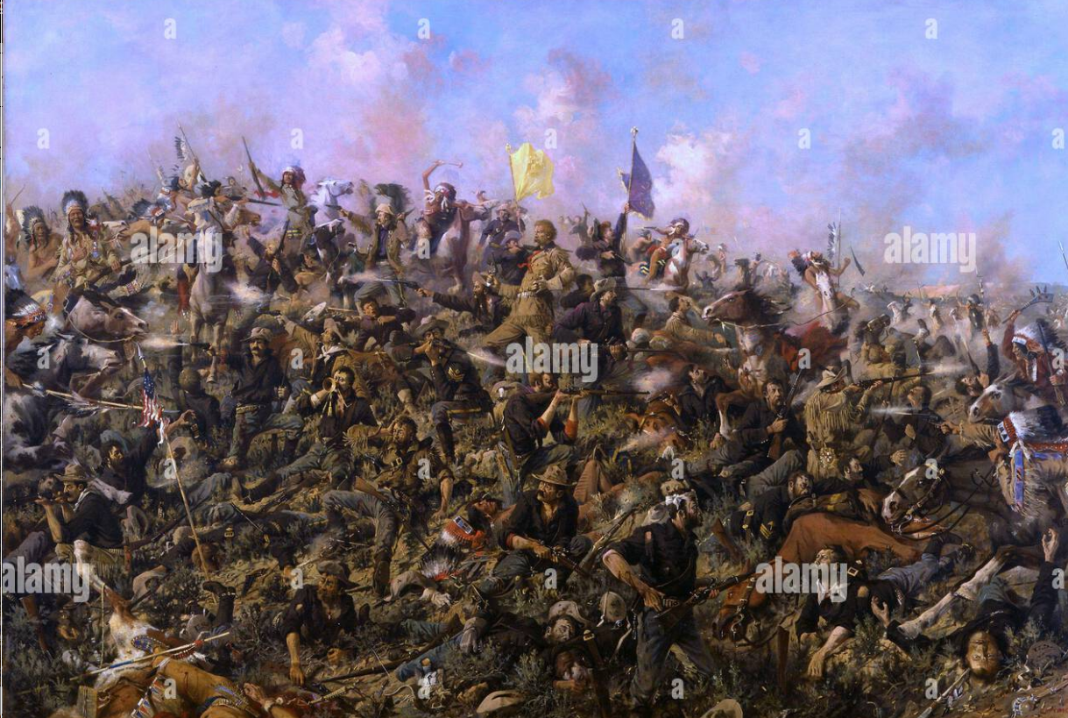
The myth: valiant last stand
Custer and 200
Men killed
Rest of army
Escapes

Slide 56
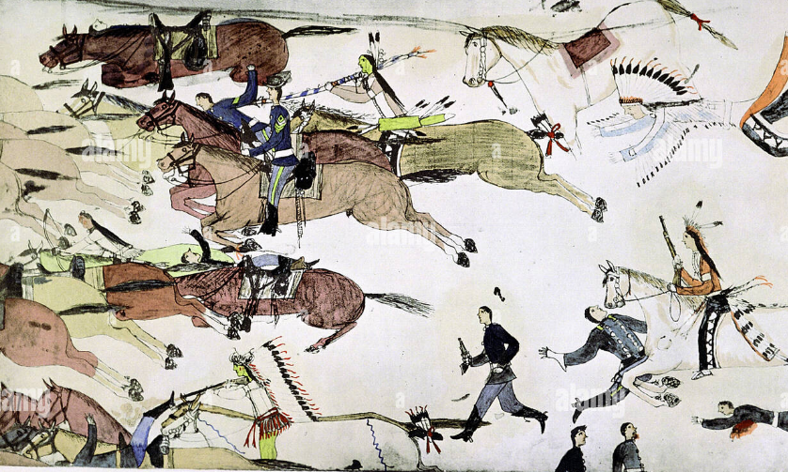
The Indian view…running for their lives
Memoirs of “White Bull” I charged in…A tall well built soldier saw me coming…We grabbed each other and wrestled in the dust and Smoke. He hit me with his fists..then grabbed my long braids
With both hands pulled my face close and
Tried to bite my nose off. …Finally I broke
Free. He drew his pistol. I wrenched it out of
His hand and and struck him three times with
my head, knocked him over shot him in the
Heart. ..That was a hard fight. But it was a
Glorious battle, I enjoyed it..
“Big Head memories "I was told that after
the battle two Cheyenne women came across
Custer's body. They knew him, because he
had attacked their peaceful village on the
Washita. These women said, 'You smoked the
peace pipe with us. Our chiefs told you that
you would be killed if you ever made war on
us again. But you would not listen.
This will make you hear better.' The women each
took an awl from their beaded cases and stuck
them deep into Custer's ears."

Slide 57
Little Big Horn aftermath
US army reinforced to 6,000
Sioux leaders flee to Canada
Warriors return to reservations and remain
Overwhelming force deployed for future Indian Wars
Nez Peerce revolt 1878 200 Indians chased by 2,500 soldiers, case of the premature tourists…
Apache in South West 1880’s overwhelmed…5,000 soldiers chase 34 ‘bandits’ for 2 years
Dawes Act 1887
Indians to be assimilated & detribalised….children removed to boarding schools
“Mixed Race” given path to citizenship
Indian culture to be obliterated

Slide 58
Intermission

